Slide 1
Classical Western Thought
3. Homeric view of Gods (II)

Slide 2
1. Zeus and World Order
1.1 Overview
Zeus holds a special place among the Homeric gods and in the Homeric conception of the universe.
He reflects some oppositions and potential conflicts that are never explicitly faced in the Homeric poems.

Slide 3
1.2 The power of Zeus
In some ways he is one god among many, though the most powerful of them.
Before there were gods heaven and earth had been formed. The Titans were their children, and the gods were their grandchildren.
Zeus, as “father of gods and men”, shared power with Poseidon and Hades, the other sons of Cronus, after they had violently overthrown their father.

Slide 4
Uranus
Gaia
Cronus
Rhea
Oceanus
Tethys
Zeus
Hera
Poseidon
Hades
Athena
Apollo
Artemis
Aphrodite
Hermes

Slide 5
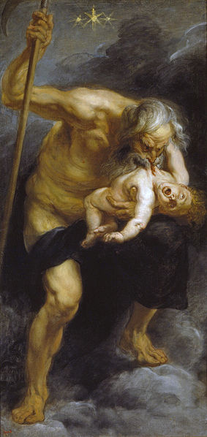
Cronus learned from Gaia and Uranus that he was destined to be overcome by his own son, just as he had overthrown his father. As a result, he devoured his children as soon as they were born. When the sixth child, Zeus, was born, his mother Rhea sought Gaia to devise a plan to save them and to eventually get retribution on Cronus for his acts against his father and children.

Slide 6
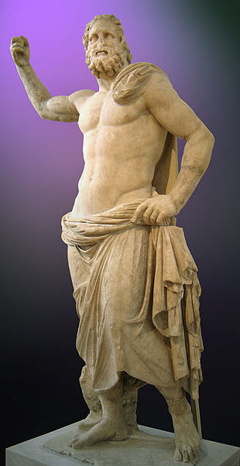
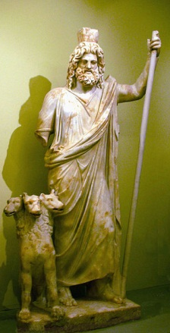

Slide 7
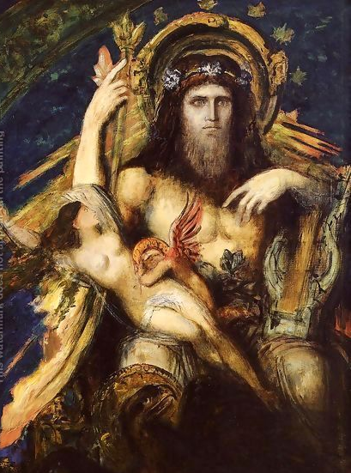
He is even distracted and seduced by his wife Hera.

Slide 8
At one point of Trojan war, the war was going so badly for the Greeks that Hera could not contain her eagerness to help.
She received glamour and love charms from Aphrodite. and, with their magic, seduced Zeus on the peaks on Mount Ida.
When Zeus saw her coming, he was so overwhelmed by desire that he praised her beauty and then went on to tell her that she was more beautiful than all the women he ever met.
While Zeus slept after the love making, Poseidon had secretly entered the battle on the side of the Greeks.

Slide 9
Zeus is stronger than all the other gods together.
His will is fulfilled in the Trojan War and the sack of Troy.
Homer insists on this at the beginning of the poem, and refers to the will of Zeus in the vicissitudes that follow.
The beginning of the Odyssey suggests that the supremacy of Zeus depends on the consent of the other gods, but that nonetheless his design is carried out.

Slide 10
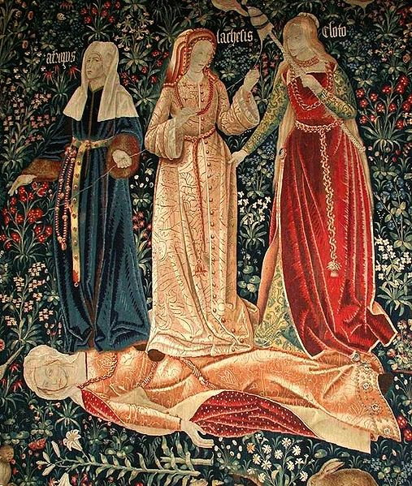
It is not always clear that Zeus’s own will is fulfilled.
Zeus is rather obscurely connected with the “fates” .
The Greek word moirai (fates) literally means a part or portion, and by extension one's portion in life or destiny.
A person’s “fate” or “portion” determines the time of his death.

Slide 11
When two heroes are fighting, Zeus weighs their two fates to see which hero has to die.
During the Trojan War, Achilles and Memnon fought. Zeus weighed the fate of the two heroes; the weight containing that of Memnon sank, and he was slain by Achilles.

Slide 12
Zeus never violates the fates, nor is he forced to follow them against his considered decision.
Zeus debated with himself whether to spare his son's life even though he was fated to die by the hand of Patroclus.

Slide 13
Comments on Homer’s fates
These fates do not constitute a single fate, a necessary order that determines each event in the universe.
Homer’s fates reflect only the vague belief that some events, and especially the time of an individual’s death, are determined by previous events beyond our control, even gods’ control.
Since order and regularity in the Homeric universe are only partial, the fates only determine some events in it.

Slide 14
Homer suggests that Zeus’s will is in control.
Zeus, unlike the other gods, seems to have wider concerns than his own honor and success.
He is also concerned with justice in human societies.
Eventually he punishes the Trojans for condoning Paris’s breach of the proper relations between host and guest.
He is angry at the breaches of justice that easily tempt Homeric heroes in their treatment of their social inferiors.
He seems to be ready to enforce the other-regarding moral requirements that seemed to be secondary in the Homeric ethical outlook.

Slide 15
2.3 The conflict of Homeric Zeus
Zeus and the fates display two tendencies in Homeric thinking that potentially conflict both with each other and with the primary Homeric ethical outlook.
The primary outlook recognizes a partially ordered universe; Homeric gods act like human beings, and care about some things that happen, while other things just happen, for no reason and in no definite order.

Slide 16
Zeus and the fates, however, suggest two different types of order.
The fates suggest an impersonal, amoral order, independent of the choices of gods or human beings.
Zeus, on the other hand, suggests a moral order, embodying an intelligence and will that transcend normal heroic values, but still belong to an intelligent moral being.
In these two different ways Homer points to possible lines of thought that go beyond the limits of his own outlook.

