Slide 1
Classical Western Thought
5. The Birth of Western Philosophy

Slide 2
1. Thales of Miletus (580 BC)
First recorded philosopher
First successful prediction of a solar eclipse
First recorded instance of universalizing (reducing multiplicity to unity)

Slide 3
If there is change, there must be some thing that changes, yet does not change.
How did orderly multiplicity come to be?
There must be a unity behind the apparent plurality of things
What is it all made of?
Could it be that all things are made of just one elemental stuff?
Men eat plants and animals
Must not the human body contain the same materials?

Slide 4
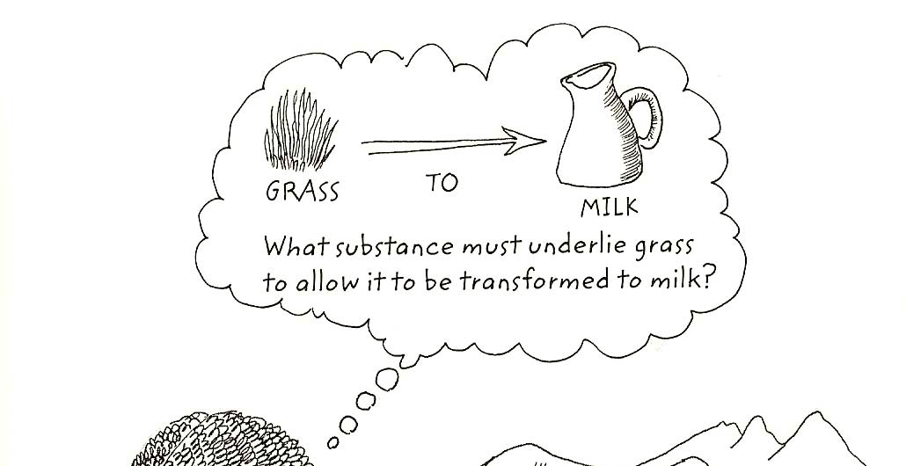
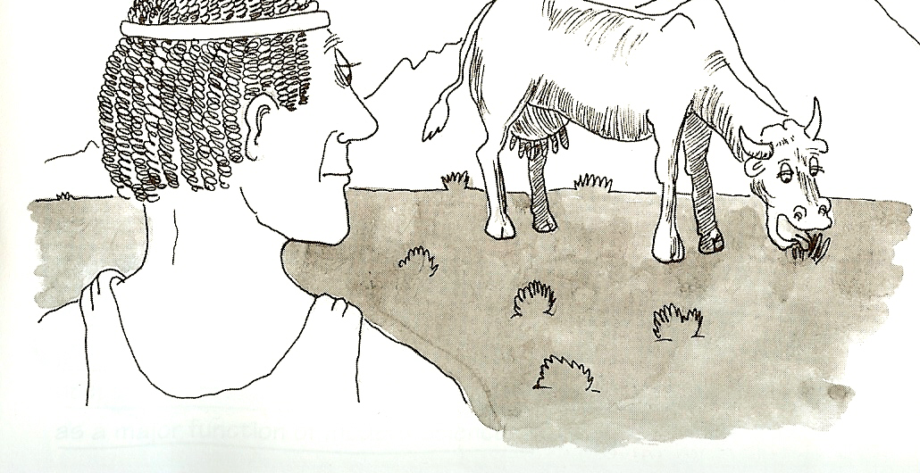

Slide 5
Unity or oneness must exist
What is the nature of this unifying, unchanging substance that is disguised by the appearance of constant change?
Air, Fire, Water, or Earth?

Slide 6
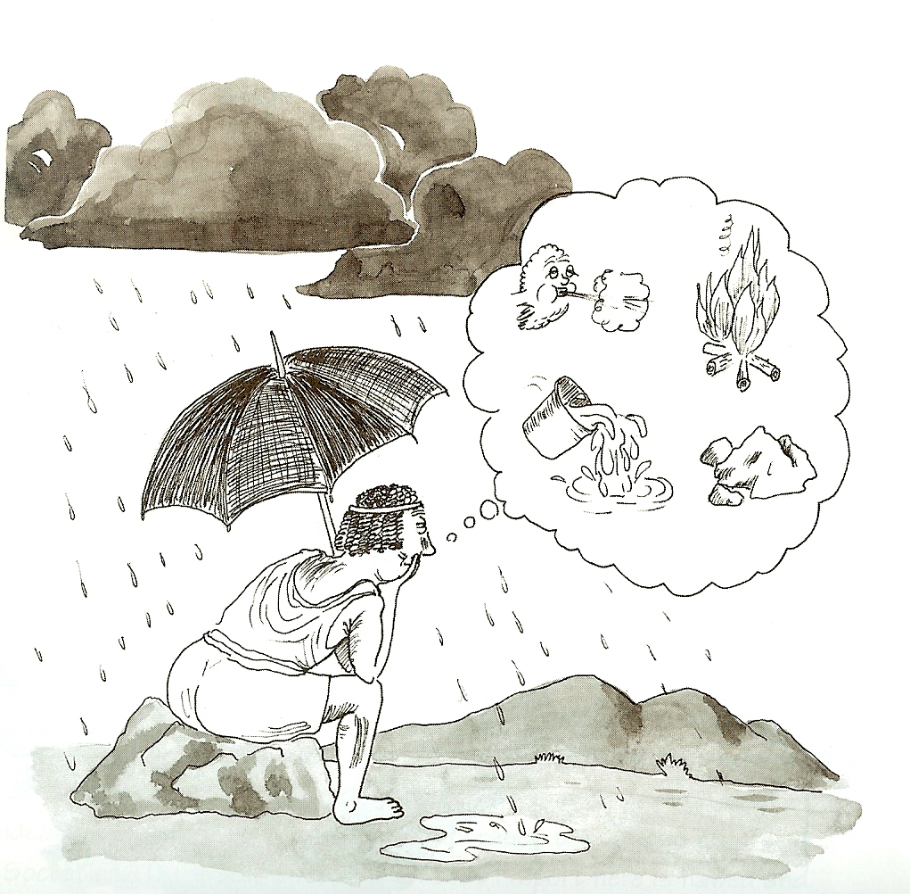

Slide 7
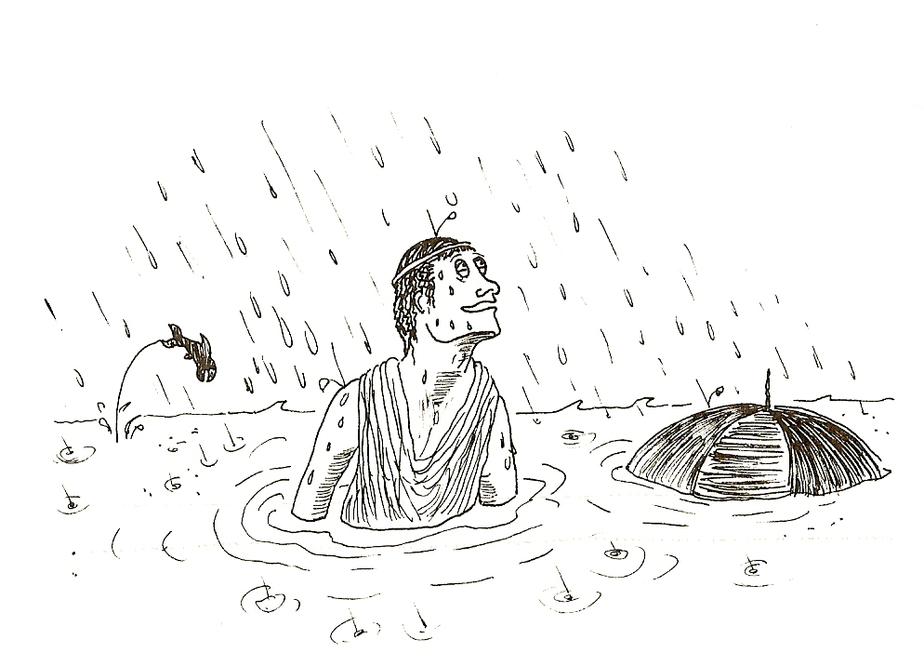
Thales decided that all things are composed of water
“The first principle and basic
nature of all things is water”

Slide 8
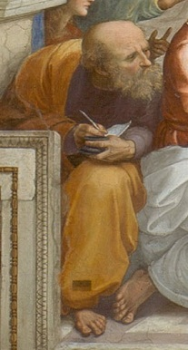
2.Anaximander (610-546 BC)
Student of Thales
Agreed that the variety of kinds of things in the world must be reducible to one category
Not satisfied with water as the single element of the universe

Slide 9
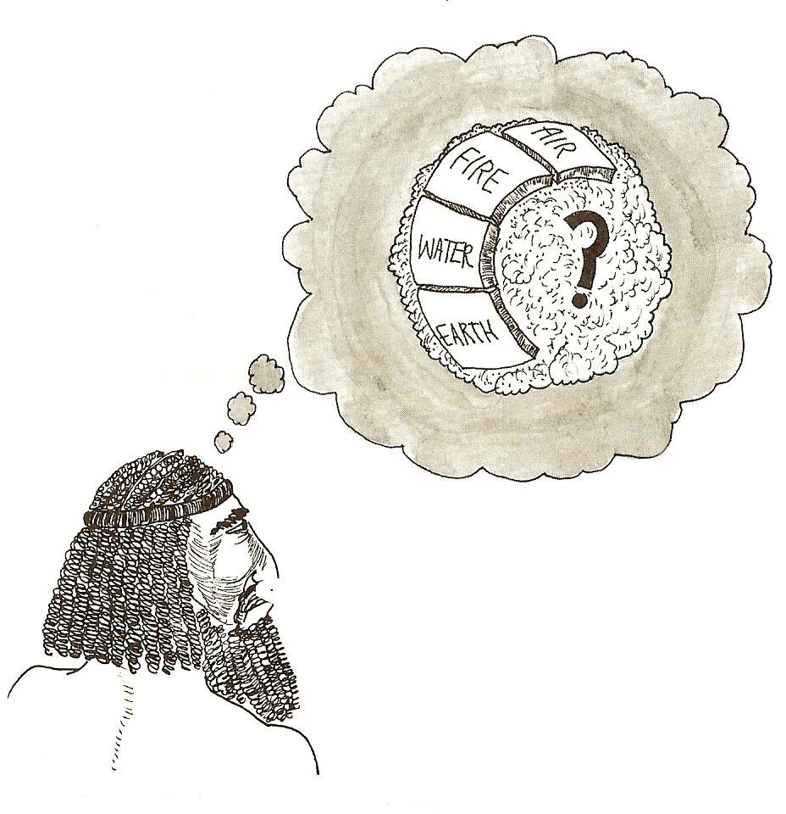

Slide 10
The ultimate stuff behind the four elements could not be one of the elements:
Water is not fire, which is not air, and air is not earth
The unifying element he call the “apeiron” or “Undefined”
The ceaseless movement of the apeiron produces a “generative source”, which is separated from the apeiron, and in turn produces the four basic opposites.
The four basic opposites constitute the different things in the world.
Eventually the opposites perish again and return to the apeiron, which has existed all along.

Slide 11
apeiron
Generative source
hot
cold
dry
wet

Slide 12
The apeiron
The apeiron seems to be the original principle of the other things, and seems to surround and govern all things.
The apeiron maintains the order of the opposites, so that they pay their injustice, in accordance with the order of time.
The apeiron has neither beginning nor end, because Anaximander rejects coming to be from nothing and destruction into nothing as violations of basic laws governing coming to be and perishing.
These claims about the apeiron show that Anaximander is concerned with law and regularity in the universe.

Slide 13
Problems
He fails to say what caused the separation of the generative source at some particular time.
Nor does he explain why the opposites return to the apeiron.
Anaximander’s main principles and general scheme express clearly the aims of naturalism; his imperfect execution of these aims suggests that a rigorous naturalist must go further.

Slide 14
3. Change and stability
Heracleitus (525-475 BC)
Lived in Ephesus
Rejected water, air, and earth as elemental stuff.
He presents a new form of naturalism that both extends and criticized Anaximander.

Slide 15
Fire is something persisting through change
Fire gives insight into the appearance of stability (unity)- for the flames form is stable; and the fact of change- for in the flame, everything changes.
This world order, the same for all, was made by no god or man, but always was and is and will be an ever-living fire, being kindled in measures and quenched in measures.
--- Heracleitus

Slide 16
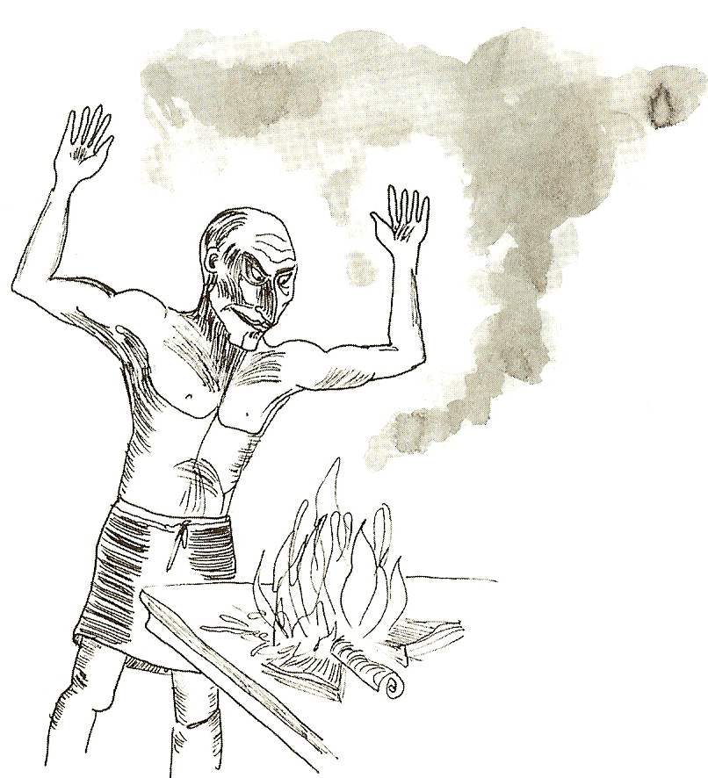
Heracleitus does not believe in the usual sort of basic subject of matter.
A bonfire is made of wood, grass, paper, leaves, etc., and it keeps burning.
There seems to be no continuing subject at all, but there is continuous process.
The continuity of the process and the discontinuity of the subjects suggest that the world order is suitably compared to a fire.

Slide 17
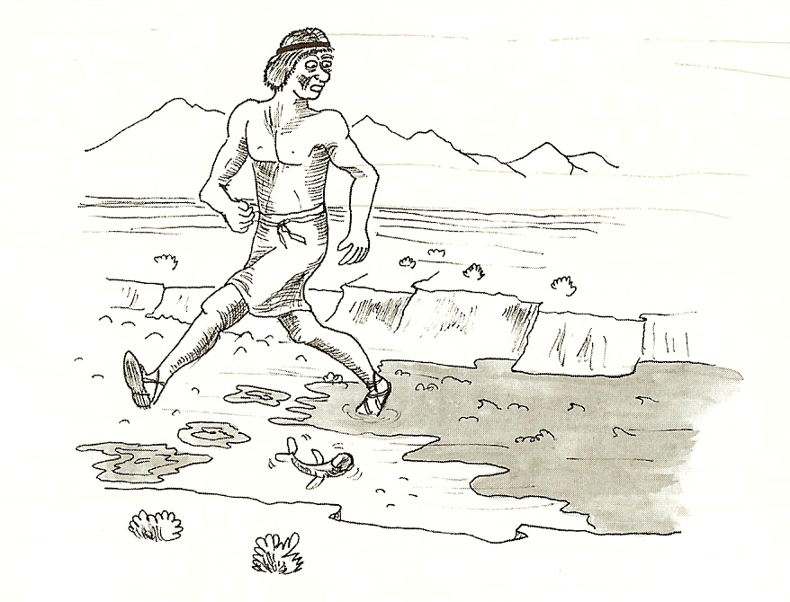

Slide 18
Ceaseless changes may seem to imply instability in the universe; but in fact they are stable because, contrary to the belief of common sense and Homer, changes conform to regular and stable laws of nature.
“The hidden order is stronger than the apparent”; there may be apparent disorder, since there are no stable objects, but there is hidden order, since they conform to regular and exceptionless laws. The whole cosmic process is regular and orderly, with no gaps.

