Slide 1
Classical Western Thought
6. Naturalist Study of History and Medicine

Slide 2
Group discussion
What’s the character of the Spartans? How are they different from the Greek heroes at Homer’s time?
How does Herodotus describe Egypt?
How does Cyrus react to the proposal of migrating to some other land? What’s the reason of his reaction?
According to Hippocrates, how should a diagnosis be made?
How does Hippocrates think of “sacred disease”?
According to Hippocrates, what’s the responsibility of being a physician?

Slide 3
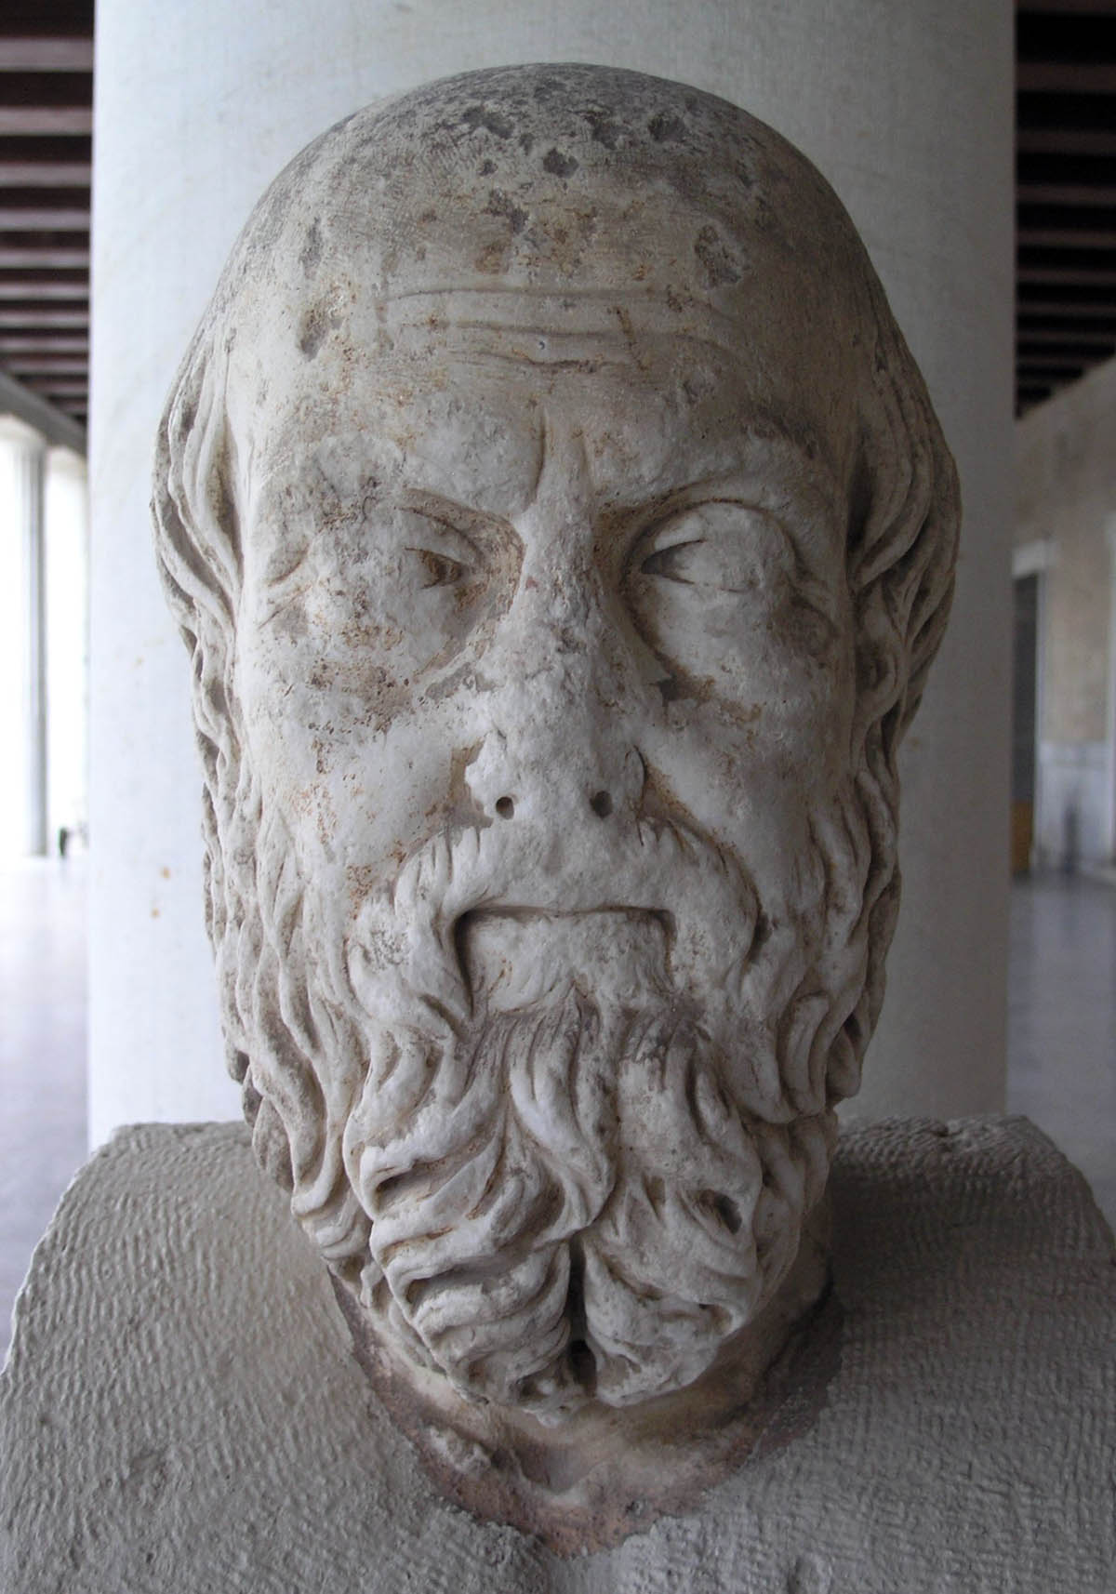
1. Nature and history
1.1 Herodotus (484-420 BC)
an ancient Greek historian
The Histories : his masterpiece
Investigate the origins of the Greco-Persian Wars.
Examines the customs, beliefs, and institutions.
"Father of History"
collect his materials systematically
test their accuracy
arrange them in a well-constructed and vivid narrative

Slide 4
1.2 Difference between Herodotus and Homer
Herodotus
Inspired by a yearning to know why.
Appealing to social, cultural, and political differences to explain the conflicts.
Homer
Inspired by Muses or Gods.
Appealing to divine will to explain the events.
Appealing to general laws, to principles about how people act.
Partially ordered world
Historical analysis and explanation
Purely epic narrative

Slide 5
1.3 Examples
He explains the bravery of the Spartans not by their individual heroism, but by their collective moral and political outlook:
The collective Spartan training and upbringing is a general explanation of their action.
The Spartans as individual fighters are inferior to no man, but together they are the best of all men. For they are free, but not free in every way; for they have law as their ruler, and they fear it far more than your subjects fear you [the Persian king]. For they do what it commands, and its command is always the same, never to flee from any mass of people in battle, but to stand firm in the line and either to overcome or to be killed.

Slide 6
He associates the Egyptians’ customs with their climate
Their river shows a nature different from other rivers.
He relies on a general principle about the natural environment and the human response to it.
Cyrus, the founder of the Persian royal house, decided to keep the Persians in rough country, not to migrate to a fertile plain.
Correspondingly their customs are opposite: the women frequent the market and carry on trade, while the men remain at home and weave; they ease themselves in their houses and they eat in the streets.
Soft country produces soft men.

Slide 7
2. Nature and medicine
During the 5th century some Greek physicians ceased to rely on magic.
Mesopotamian & Egyptian
limited surgery and a few useful drugs
evil outside forces cause diseases
Homer
He blamed diseases on divine intervention by the gods.
Naturalist physicians
Diseases are caused by the lack of the balance of basic elements of bodies.
Doctors aimed to find the general laws that cure the disease.
Doctors aimed to intercede with these evil forces outside.

Slide 8
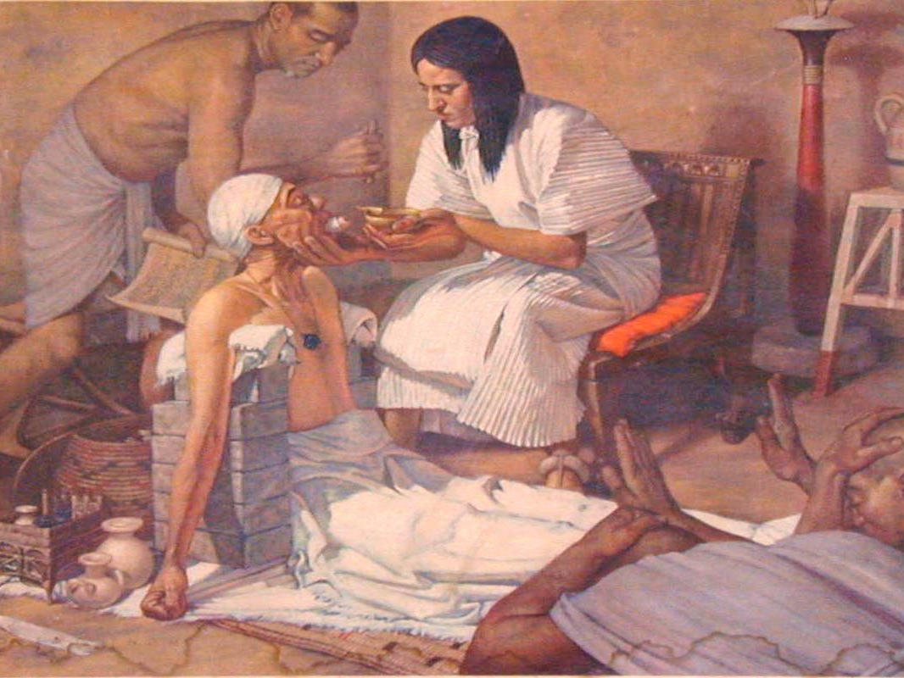
Egyptian medicine

Slide 9
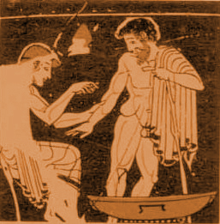
A Greek doctor letting blood out of a patient

Slide 10
Doctors are trying to find general laws about the constitution of the body.
The following were the circumstances of the diseases from which we made our diagnosis; we learnt from the common nature of all things and the special nature of each thing, from the disease, the patient, the treatment applied and the one applying it.

Slide 11
The doctor sees regularity among diseases
All diseases have the same manner; but their places differ. And so diseases seem to be quite unlike each other because of this difference in their places, but in fact they all have a single character and cause…
It may seem that all this is concerned with the heavens; but if we consider it afresh we will find that study of the stars makes no small contribution, but an extremely large one, to medicine. For with the changes in the seasons, men’s diseases and digestive organs change too.

Slide 12
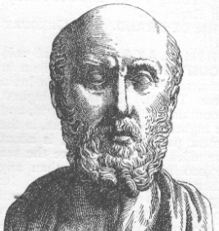
Hippocrates and epilepsy
Hippocrates of Cos (460 BC –370 BC) was an ancient Greek physician.
He is referred to as the father of Western medicine.
He is trying to work out a logical system for understanding diseases.
The Hippocratic Oath

Slide 13
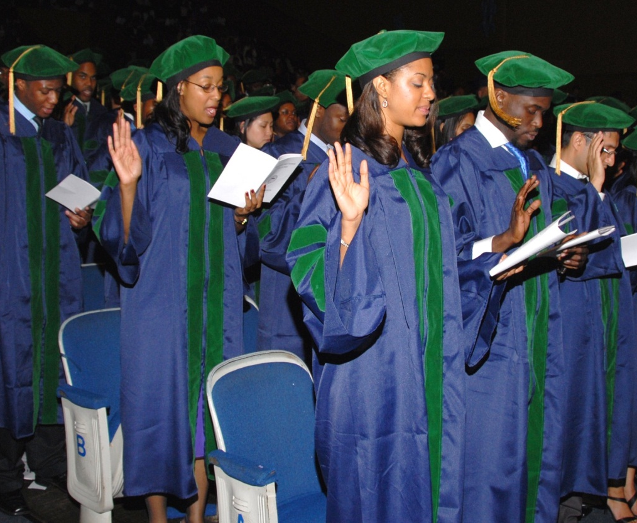
The Hippocratic Oath
The oath is still in use in modern western world
…
I will prescribe regimens for the good of my patients according to my ability and my judgment and never do harm to anyone.
I will not give a lethal drug to anyone if I am asked, nor will I advise such a plan; and similarly I will not give a woman a pessary to cause an abortion.
…

Slide 14
Hippocrates attacks the traditional attitude to epilepsy
Traditional attitude
Epilepsy was called “sacred disease”
Hippocrates
It is not sacred at all.
It seems to be a interference by the gods, disturbing the ordinary course of things.
It has a nature and an explanation – brain disorder.
Men thought it as sacred, only because they are inexperienced and prone to amazement.

Slide 15
The naturalist perspective on medicine
The naturalist doctor denies that any disease results from extraordinary divine intervention, or from inexplicable chance.
Each of these diseases has its own nature, and none comes about independently of nature… For when chance is examined it turns out to be nothing; for everything that comes to be is found to come to be for some cause, and in this cause chance turns out to have no reality but to be an empty name.

