Slide 1
Classical Western Thought
8. The trial and death of Socrates

Slide 2
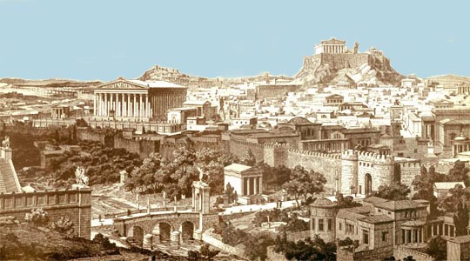
1. Background of the trial: Athenian democracy
Athens is a city-state or polis. The polis was roughly the size of one of our current counties and contained one major city or town.

Slide 3
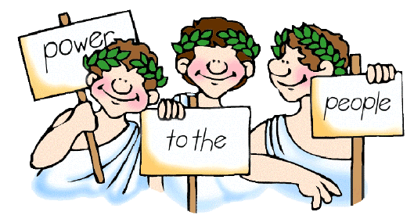
The ancient Greek word demokratia meant literally 'people-power'.
"It is true that we (Athenians) are called a democracy, for the administration is in the hands of the many and not the few”.

Slide 4
Each year, 500 names were drawn from all the citizens of Athens. Those 500 citizens had to serve for one year as the law makers.
All citizens of Athens were required to vote on any new law that this body of 500 citizens created. One man, one vote, majority ruled. Women, children, and slaves were not citizens, and thus could not vote.
Every citizen has a responsibility for the state.

Slide 7
2. Socrates on Trial
Public opinions on Socrates
Socrates’ questioning made people uncomfortable.
In the Laches the Athenian general Nicias warns his friends:
you seem not to know that if you meet Socrates in discussion, you are bound to find that even if you begin by discussing something else, before you are done you will be led around in argument by Socrates, until you are trapped into giving an account of yourself– of how you are living your present life and how you have lived your life in the past. And once you are trapped, Socrates will not let you go until he has tried and tested you thoroughly on each point.

Slide 8
In the Gorgias Callicles sees that the results of a Socratic examination may be unpleasant:
Tell me, Socrates, should we take you to be joking or in earnest? If you’re in earnest, and what you say is true, doesn’t it follow that our human life is upside down, and that everything we do is the exact opposite, it would seem, of what we ought to do?

Slide 9
Socrates aroused suspicion because of the company he kept.
He was himself neither rich nor well-born.
He found rich and aristocratic young men to be both sexually attractive and suitable partners in philosophical discussion.
These young men became his disciples, and at the same time his patrons.
Some of his students were bitter and ruthless conspirators against the democracy.

Slide 10
Socrates’ trial (399 BC)
Two charges against Socrates
The first charge was religious:
Impeity: believing not in the gods whom the state believes in.
The second charge was moral:
Making the inferior argument superior
Corrupting the young men.
Jury of 500 found Socrates guilty.
Sentenced to death… Could have escaped into exile. Choose to accept death sentence.

Slide 11
Socrates’ defense
What vocation has Socrates devoted himself to?
Why does Socrates think the Athens should be ashamed?
What does Socrates care about the most?
Why does Socrates compare himself to a gadfly?
Why Socrates did not choose to run away?

Slide 12
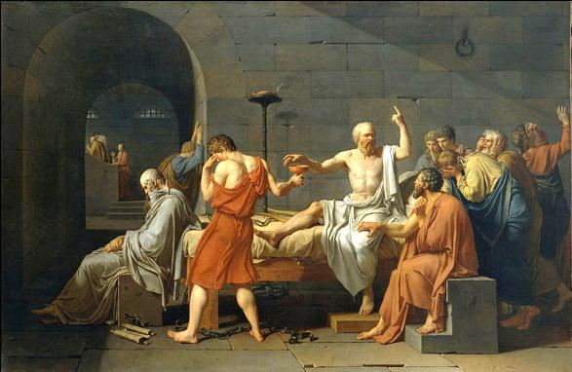
Socrates was sentenced to die by drinking the poison hemlock

Slide 13
Discussion question
If you were Socrates, would you choose to stay or ran away?

